Slide 1


Hierarchical Clustering for Automatic File Classification:
A Study on Scalable Approaches
Kameswaran R (2020239007)
Vishwaranjani S (2020239023)
Vigneshwarann Vijayakumar (2020242023)

Slide 2
Problem Statement:
In today's digital age, data is generated and stored in various formats, such as text documents, images, audio files, and binary files. However, these files often lack proper categorization or labeling, leading to challenges in organizing, searching, and analyzing them effectively. The heterogeneity in file types and their characteristics further complicates the classification task.
Hierarchical clustering offers a promising solution for this challenge by grouping unlabeled files into meaningful clusters based on their similarity. This technique provides a tree-like structure, enabling users to visualize relationships and uncover patterns within the data.

Slide 3
Objective:
The objective of this project is to develop a hierarchical clustering framework for the automatic classification of unlabeled files. By leveraging tailored feature extraction methods specific to diverse file types—such as text documents, images, audio files, and binary files.
The ultimate goal is to offer a robust, generalizable solution for classifying and understanding unlabeled file collections in domains such as digital forensics, data management, and content organization.

Slide 4
Hierarchical Clustering for unlabeled files:
The provided code implements a Classification of unlabeled files using hierarchical clustering. The system uses Heuristic-based methods for feature extraction to process the files. Such as
Text files: Hash-based representation.
Image files: Grayscale conversion and resizing.
Audio files: Spectrogram extraction.
Binary files: Byte frequency distribution.

Slide 5
Text Feature extraction:
Hash-based representation refers to the use of cryptographic hash functions (like MD5, SHA-256, etc.) to convert a block of text into a fixed-size string or vector of characters/numbers. This representation is deterministic, meaning the same input will always produce the same hash, and it is compact, regardless of the original text size.
This representation is lightweight and computationally efficient, making it suitable for high-level comparisons, duplicate detection, or identifying similar files without delving into detailed semantic or structural features.

Slide 6
Code Snippet:

Slide 7
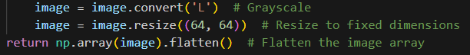
Image feature extraction
This process refers to the transformation of image data into a standardized format by converting it to grayscale and resizing it to a fixed dimension. It is a common preprocessing step in image analysis and machine learning workflows to ensure consistency and reduce computational complexity.

Slide 8
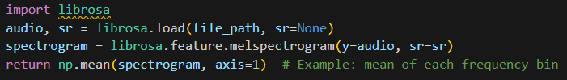
Audio feature extraction:
Spectrogram feature extraction refers to the process of converting an audio signal into a visual representation of its frequency content over time (a spectrogram) and then using that spectrogram to derive meaningful numerical features that can be used for further analysis, such as classification, clustering, or machine learning tasks.

Slide 9
Binary files feature Extration:
Byte frequency distribution is a technique used to convert binary or non-textual data into numerical representations that can be processed by machine learning algorithms. This method is particularly useful for files where textual or structured data extraction is not applicable. Instead, the raw byte data is analyzed to extract patterns based on the frequency of each byte value (ranging from 0 to 255).

Slide 10
Other files feature extraction:
Combining file size and hash-based encoding is a technique used to create a unique numerical or vector-based representation of a file. The combination of these two features helps capture both structural and content-specific information about the file, which can be useful for various tasks such as file classification, similarity analysis, and file identification.

Slide 11
Jaccard Similarity
The Jaccard Similarity (or Jaccard Index) is a statistical measure used to quantify the similarity and diversity between two sets.In this project Jaccard Similarity is used to compare files based on their feature representations.
Since we are dealing with different file types (text, images, audio, etc.), these features might represent different types of information, such as words in text files, pixel intensities in images, or byte frequencies in binary files.

Slide 12
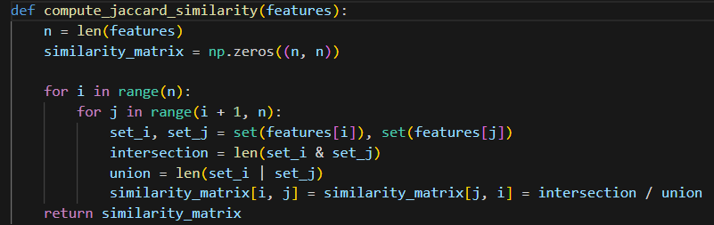
Code Snippet:

Slide 13
Hierarchical Clustering:
In this project, we perform hierarchical clustering using the similarity matrix we obtained. Hierarchical clustering works by iteratively merging the closest pairs of clusters.
In agglomerative clustering, the process begins by treating each file as its own cluster, and then clusters are merged based on their similarity until all files are grouped into a single large cluster.

Slide 14
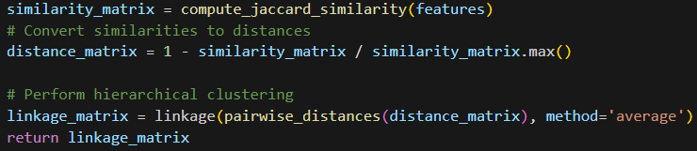
Code Snippet:

Slide 15
Dendrogram:
A dendrogram is a tree-like diagram that is commonly used to illustrate the arrangement of the clusters produced by hierarchical clustering. It visually represents how files are grouped together based on their similarity or distance.
Linkage matrix from the hierarchical clustering is illusatrated as dendrogram.

Slide 16
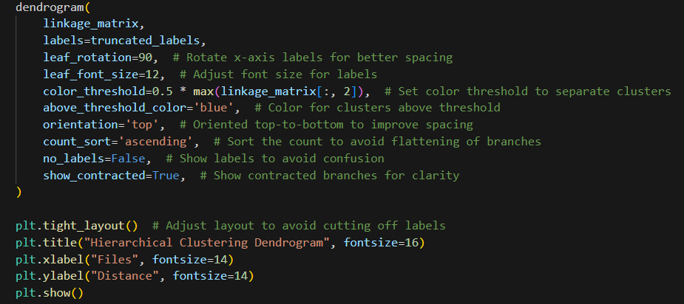
Code Snippet:

Slide 17
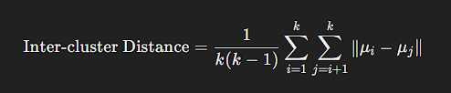
Inter-cluster Distances:
Inter-cluster distance refers to the measure of separation between different clusters in a clustering analysis. This metric is crucial for evaluating the quality and effectiveness of clustering algorithms, as it helps determine how distinct and well-separated the clusters are from each other.

Slide 18
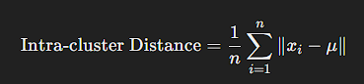
Intra-cluster Distances:
Intra-cluster distance measures how close the data points within a single cluster are to each other. It is typically calculated as the distance between each data point and the cluster centroid. The smaller the intra-cluster distance, the more similar the data points are within that cluster.

Slide 19
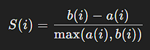
a(i): The average distance of point
𝑖
i to all other points in the same cluster.
𝑏
(
𝑖
)
b(i): The average distance of point
𝑖
i to points in the nearest neighboring cluster (the next best fit cluster).
𝑆
(
𝑖
)
S(i): The Silhouette Score for point
𝑖
i, ranging from
−
1
−1 to
1
1.
Silhouette Score:
The Silhouette Score is a metric used to evaluate the quality of clustering in data. It measures how similar a data point is to its own cluster compared to other clusters. The score helps determine the appropriateness of the clustering results, where a higher score indicates well-defined clusters.
a(i) - The average distance of point i to all other points in the same cluster.
b(i) - The average distance of point i to points in the nearest neighboring cluster (the next best fit cluster).
S(i) - The Silhouette Score for point i, ranging from
−1 to 1

Slide 20
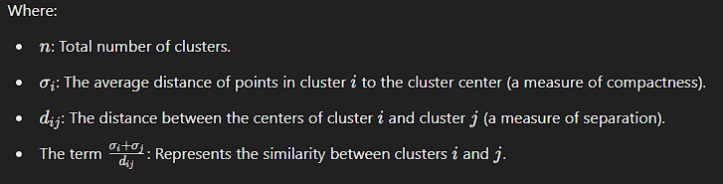
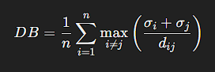
Davies-bouldin score:
The Davies-Bouldin Score is a metric used to evaluate the quality of clustering results by analyzing how well-separated and compact the clusters are. A lower Davies-Bouldin Score indicates better clustering, as it reflects clusters that are compact and well-separated from one another.

Slide 21
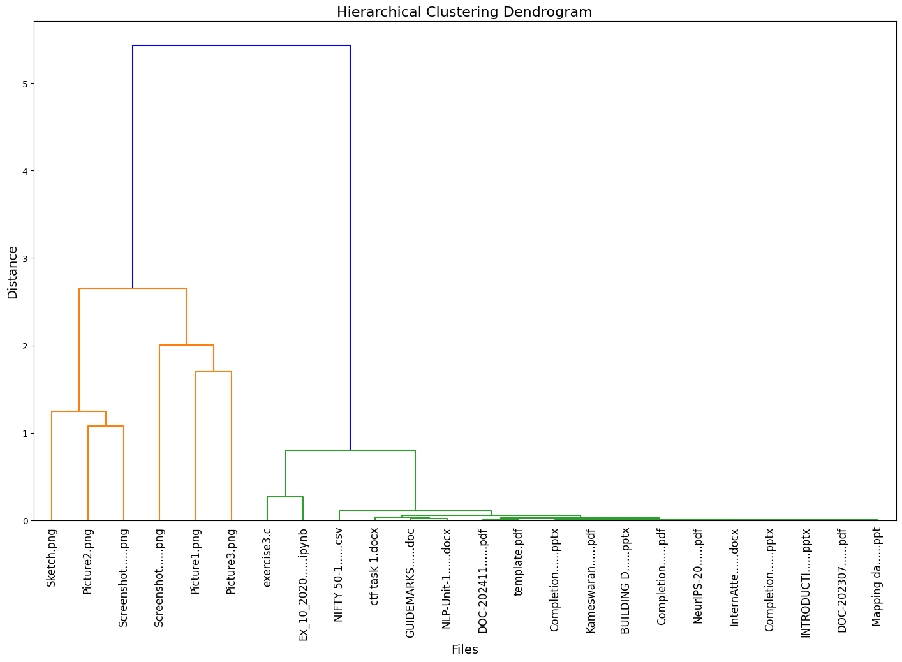
Results:
Dendrogram

Slide 22
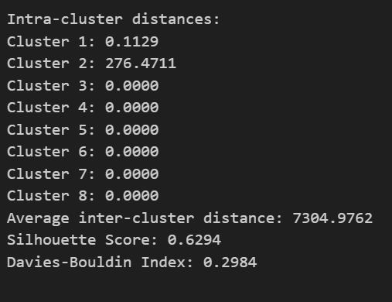
Results:
Scores

Slide 23
THANK YOU

